Slide 1

Data Mining Project
Game of Thrones

Slide 2

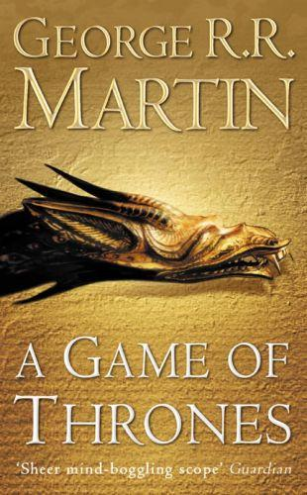
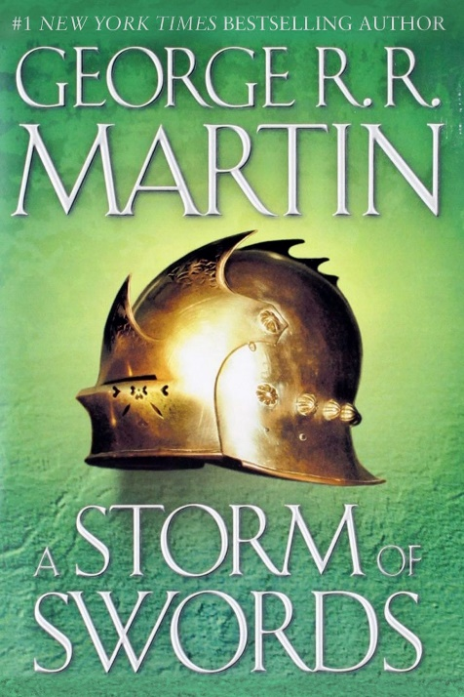

Intro and dataset
Game of Thrones is a series of five books written by George R. R. Martin between 1996 and 2011
Three main stories interweave: a dynastic war among several families, the rising threat of the supernatural and the ambition of the deposed king's exiled daughter to assume the “Iron Throne”

Slide 3

Problem statement
We aim to investigate the differences in author’s writing style from the first book of his series up to the third one. We hope to discover his pattern of choices while manipulating the characters ( they have a tendency to die) as well as the preferred atmosphere and intercalation of the three main storylines.

Slide 4
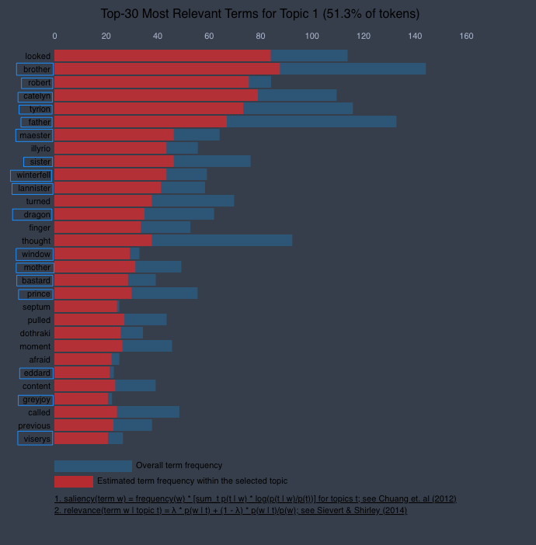
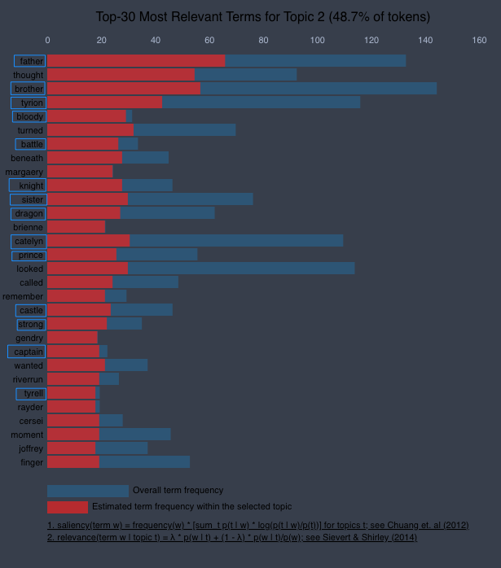
Atmosphere
Approach : topic analysis
Houses : Lannister, Grayjoy, Tyrell
Characters : Robert, Catelyn, Tyrion, Viserys
Thematic words: prince, dragon, bloody, battle, knight, castel, strong
Relations: brother, father, sister, master, bastard

Slide 5
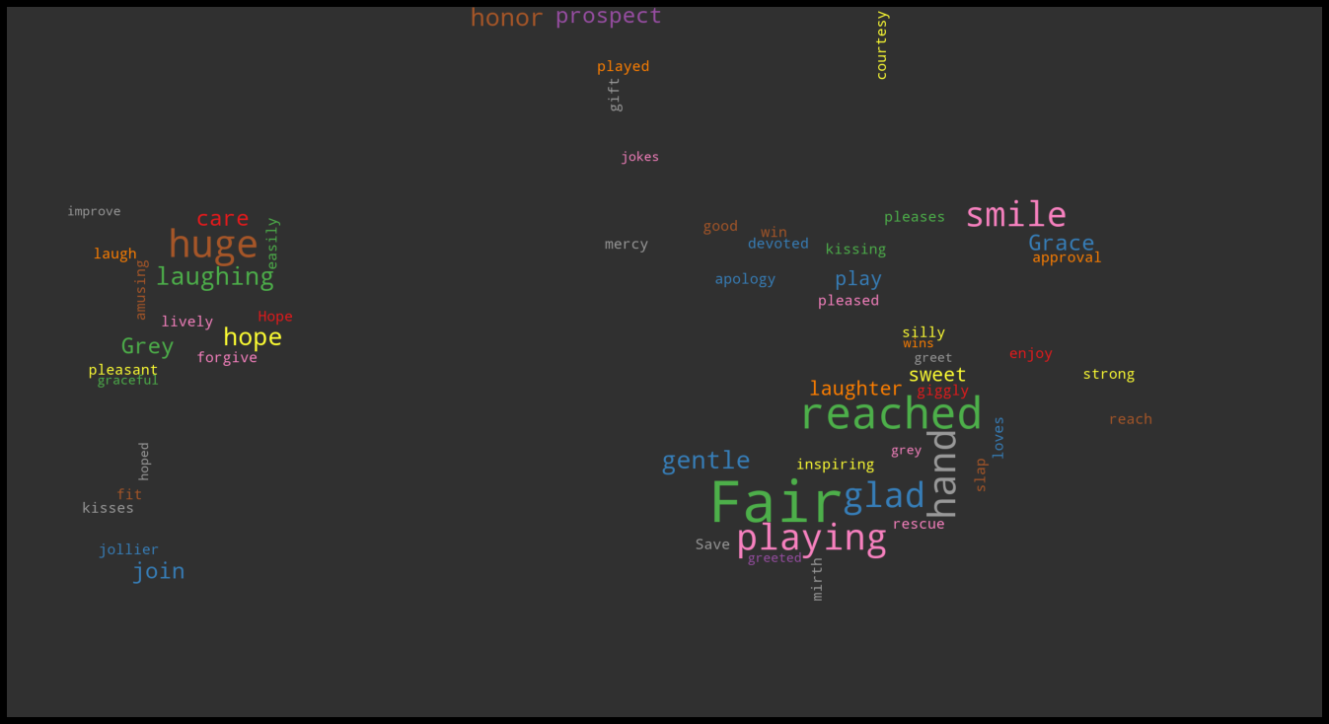
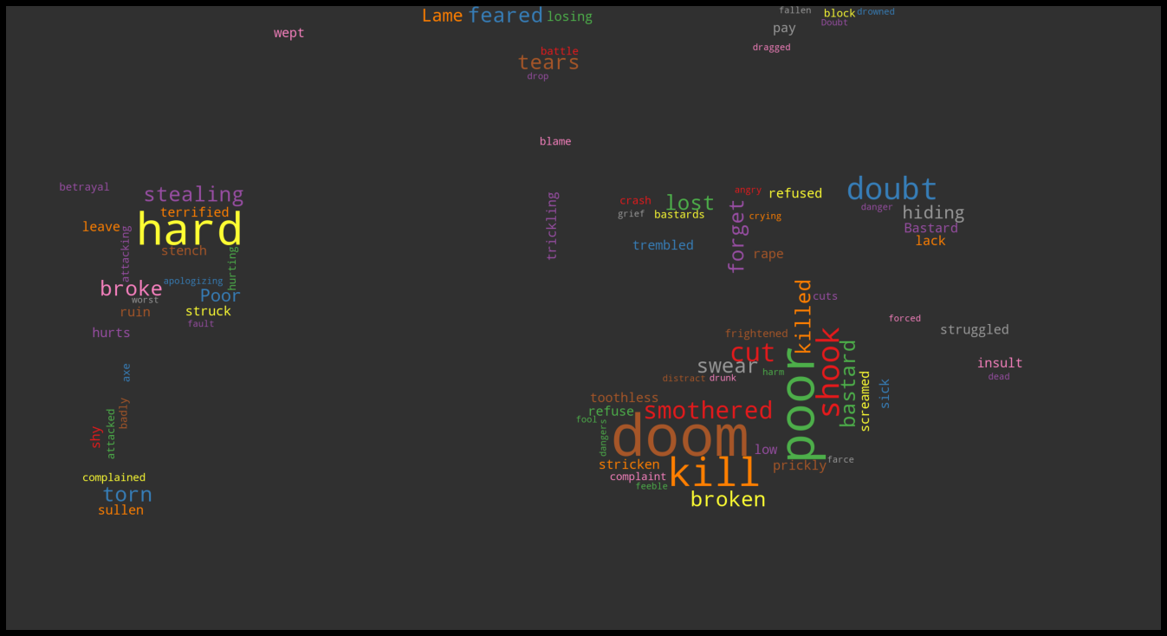
Atmosphere
Approach : sentiment analysis
Event analysed : Red wedding
Balance between the two opsites phenomenons: wedding & massacre
Negative sentiment slightly predominant
Lower positive intensity: fair, glad, smile, gentle
Higher negative intensity: doom, kill, poor, cut, killed, rape

Slide 6
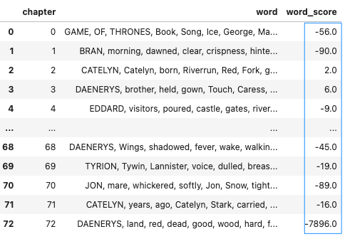
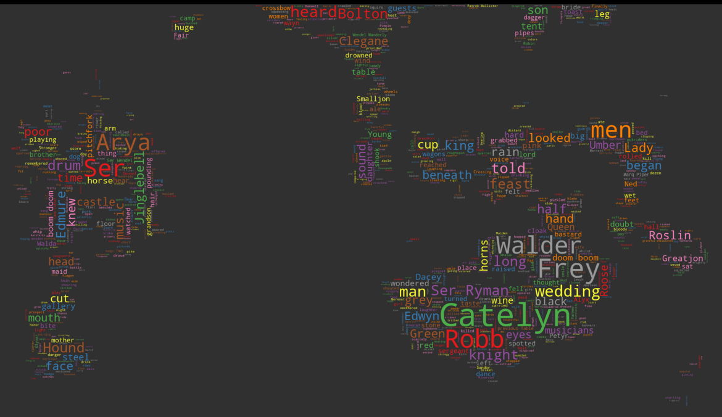
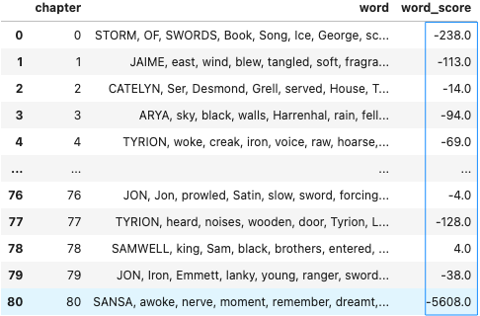
Atmosphere
Approach : sentiment analysis

Slide 7
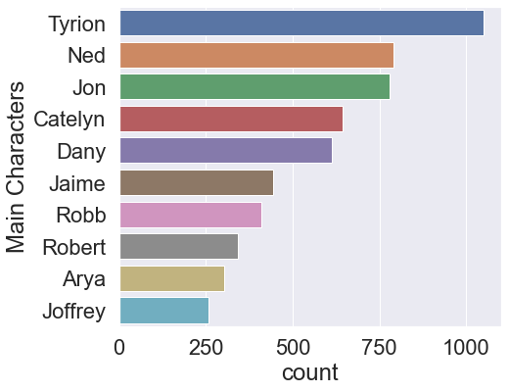
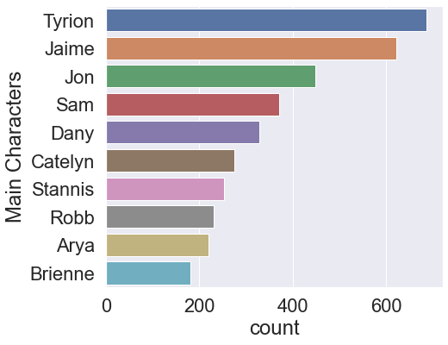
Characters
Approach : word frequency
Main characters : Tyrion, Jon, Dany
Consistent characters: Tyrion, Jon, Dany, Catelyn, Jamie, Robb, Arya
Possibly dead: Ned, Robert, Joffrey

Slide 8
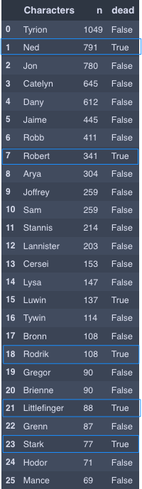
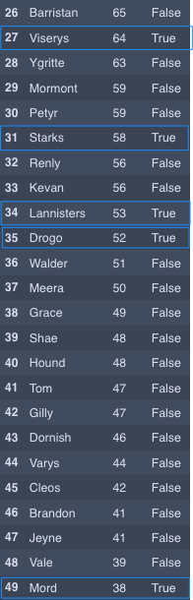
Characters
Approach : word frequency
Dead charcters :
Ned
Robert
Rodrik
Littlefinger
Stark
Viserys
Drogo
Mord
Rate of death : aprox 20%

Slide 9
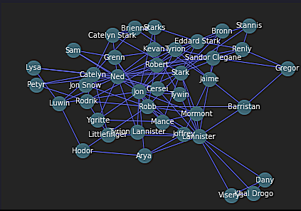
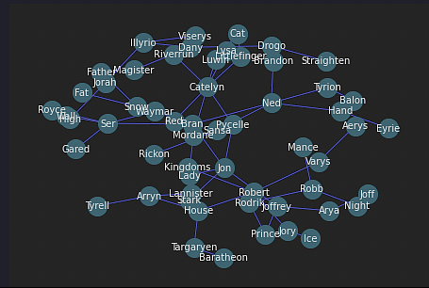
Atmosphere
Approach : complex (NER)
Approach : naive (bigrams)

Slide 10
Conclusions
As we had expected, the variety of data mining algorithms applied to our dataset provided us with valueable information about the novels
A good understanding of envionement and society, characters and relationships between them, overall vibe and emotions throughout and even a hunch about what to expect from future books
Git_repository_data_mining_project

